Slide 1

TIENG ANH 7
UNIT 2
PERSONAL INFORMATION
Section A 1,3,4

Slide 2
Objectives – Mục tiêu cần đạt
Be able to listen and read telephone number. (có thể nghe và đọc số điện thoại)
Listen and identify the telephone number of themselves and their friends. (nghe và nhận dạng số điện thoại của mình và của bạn bè.)
Practice listening, reading and writing skill. (luyện tập kỹ năng nghe, đọc và viết)

Slide 3
Chuẩn bị:
Từ vựng về số đếm và cách đọc số
Các học sinh chép trước từ vựng
mới vào vở

Slide 4
New words
personal (adj)
information (n)
telephone directory (n)
telephone number (n)
soon ≠ late (adv)
call (v)

Slide 5
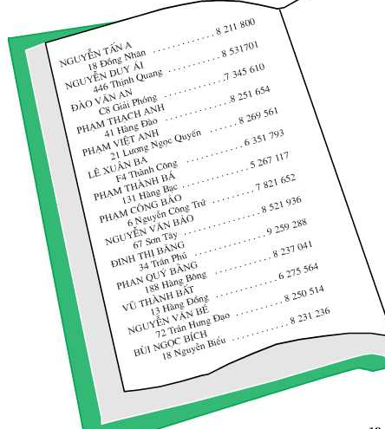
A1. Read
(page 19)
Telephone directory

Slide 6
Practice with a partner.
Say the telephone number for these people
Dao Van An Pham Viet Anh Pham Thanh Ba | Dinh Thi Bang Vu Thanh Bat Bui Ngoc Bich

Slide 7

A3. Listen (page 20)
Lan: Excuse me, Hoa.
Hoa: Yes. Lan?
Lan: What’s your telephone
number?
Hoa: 8 262 019.
Lan: Thanks. I'll call you soon.

Slide 8
A4. Listen. Then practice with a partner ( page 21)
Các em cần chuẩn bị:
►Ghi trước từ mới trong bài: will, free, late, start.
►Tìm hiểu trước nội dung bài học, trả lời các câu hỏi:
a. Who will meet tomorrow?
b. What will they do?
c.What time will they meet?
d. Where will they meet?

Slide 9

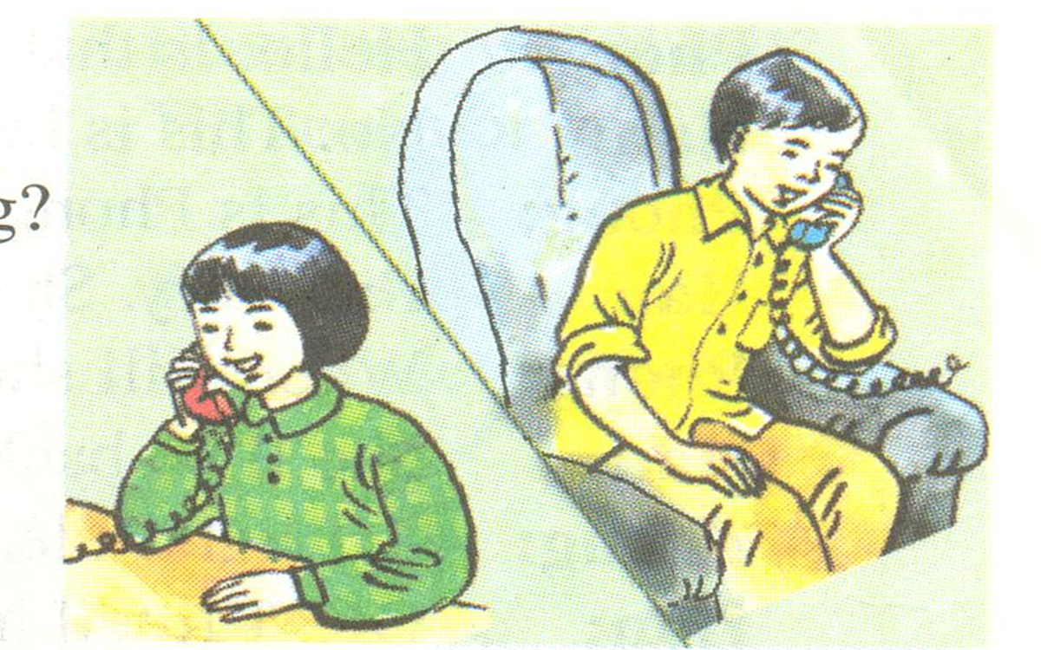
Phong: Hello. This is 8 537 471.
Tam:Hello. Is this Phong?
Phong: Yes. Who’s this?
Tam:It’s me ,Tam. Will you be free tomorrow evening?
Phong : Yes, I will.
Tam: Would you like to see a movie?
Phong: Sure . What time will it start?
Tam: It’ll start at seven o’clock. Let’s meet at 6.45.
Phong: Where will we meet?
Tam: We’ll meet in front of the movie theater.
Phong : Great. I’ll see you tomorrow. Don’t be late.

Slide 10

Unit 2
Personal information
B1,2,3,4

Slide 11

Preparation
Students review how to write
- ordinal numbers from 1st to 31st
- the months in order from first to twelfth.
Students prepare new words:
- date of birth
- nervous
- worry

Slide 12
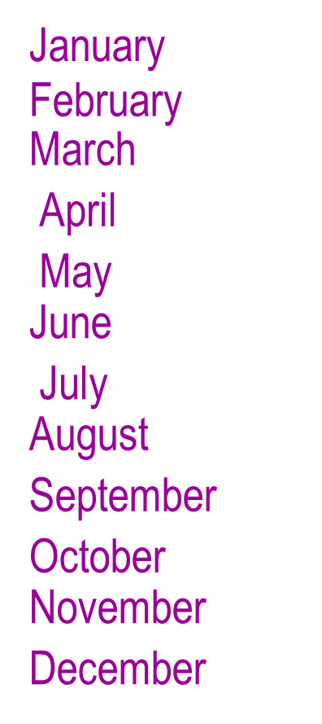

B2.Write the months in the correct order
1.
2.
3.
4.
5.
6.
7.
8.
9.
10.
11.
12.

Slide 13
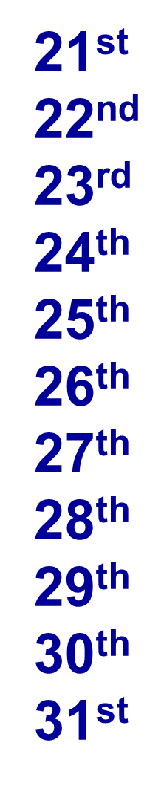
Write ordinal numbers from 1st to 31st
→ twenty-first
→ first
→ eleventh
1st
2nd
3rd
4th
5th
6th
7th
8th
9th
10th
11th
12th
13th
14th
15th
16th
17th
18th
19th
20th
→ twenty-second
→ second
→ twelfth
→ twenty-third
→ third
→ thirteenth
→ twenty-fourth
→ fourth
→ fourteenth
→ twenty-fifth
→ fifth
→ fifteenth
→ twenty-sixth
→ sixth
→ sixteenth
→ twenty-seventh
→ seventh
→ seventeenth
→ twenty-eighth
→ eighth
→ eighteenth
→ twenty-ninth
→ ninth
→ nineteenth
→ thirtieth
→ tenth
→ twentieth
→ thirty-first

Slide 14
Thank you!

